Slide 1
Car Price Prediction Analysis
By
SUBHIKSHA
DADS OCT BATCH

Slide 2
Dataset Overview
Dataset Description: The dataset contains car listings with various attributes such as brand, model, year, mileage, engine type, fuel type, and price.
Key Attributes:
Make & Model – Brand and model of the car
Year – Manufacturing year
Mileage – Distance traveled
Fuel Type – Petrol, Diesel, Electric, etc.
Transmission – Automatic or Manual
Price – Selling price of the car (Target Variable)

Slide 3
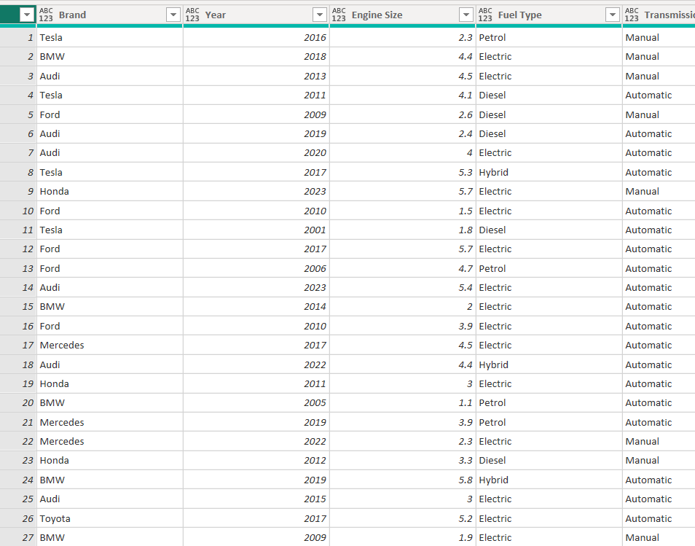
Data Cleaning Process
Removed missing and duplicate entries.
Converted categorical variables (e.g., fuel type, transmission) into numerical representations.
Normalized continuous variables (e.g., mileage, price) for better predictions.

Slide 4
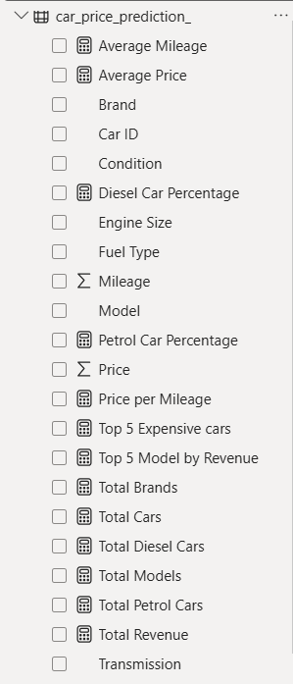
DAX Functions Used
CALCULATE: Used to modify filter contexts and derive insights.
SUM, AVERAGE: Used for total and average price calculations.
IF: Applied for conditional transformations.
COUNTROWS: Counts the number of rows in a table.
TOPN: Returns the top N rows from a table based on a specified expression.

Slide 5
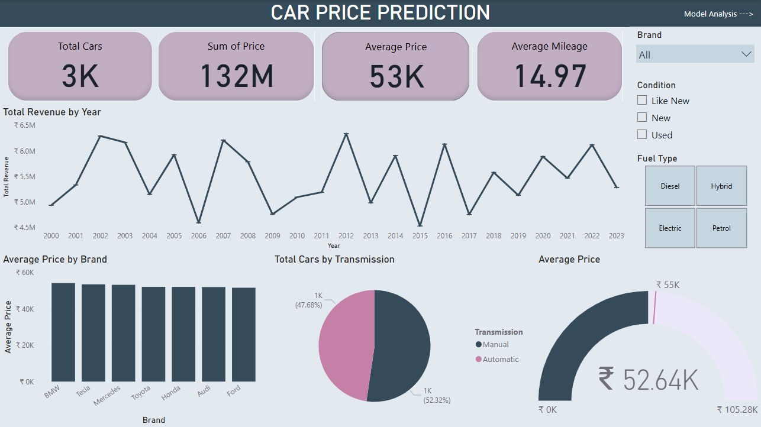

Slide 6
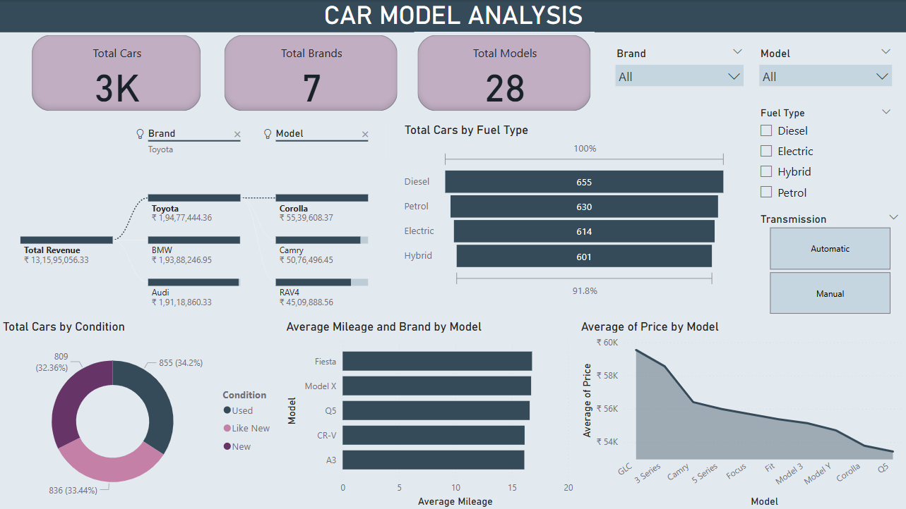

Slide 7
Insights
Top revenue brands: Toyota, BMW, Audi.
Top mileage models: Fiesta, Model X, Q5.
52.32% prefer automatic cars, 47.68% prefer manual.

Slide 8
Recommendations
Focus on luxury buyers with financing for Mercedes, Tesla, BMW.
Stock more Toyota, BMW, Audi top models.
Market benefits of manual cars to 47.68% manual buyers.
Offer discounts, trade-ins & financing to boost sales.

Slide 9
THANK YOU
By
SUBHIKSHA
DADS OCT BATCH

